Slide 1
Session 3: Database Technology
Lecturer: Dr. Le Hoang Son
Vietnam National University (VNU)
lehoangson@hus.edu.vn
sonlh@vnu.edu.vn

Slide 2
Contents
1
Database
2
Database Terminology
3
Data Model Overview
4
Database architecture
5
Database Management System
6
Database Market

Slide 3
1. Database
Your personal address book in a Word document
A collection of Word documents
A collection of Excel Spreadsheets
A very large flat file on which you run some statistical analysis functions
Data collected, maintained, and used in airline reservation
Data used to support the launch of a space shuttle

Slide 4
Models of Reality
DML
DATABASE SYSTEM
REALITY
structures
processes
DATABASE
DDL
A database is a model of structures of reality
The use of a database reflect processes of reality
A database system is a software system which supports the definition and use of a database
DDL: Data Definition Language
DML: Data Manipulation Language

Slide 5
Why Use Models?
Models can be useful when we want to examine or manage part of the real world
The costs of using a model are often considerably lower than the costs of using or experimenting with the real world itself
Examples:
  airplane simulator
  nuclear power plant simulator
  flood warning system
  model of US economy
  model of a heat reservoir
  map

Slide 6

A Map Is a Model of Reality

Slide 7
A Message to Map Makers
A model is a means of communication
Users of a model must have a certain amount of knowledge in common
A model on emphasized selected aspects
A model is described in some language
A model can be erroneous
A message to map makers: “Highways are not painted red, rivers don’t have county lines running down the middle, and you can’t see contour lines on a mountain” [Kent 78]

Slide 8
Use a DBMS when this is important
Tips
Do not use a DBMS when
persistent storage of data
centralized control of data
control of redundancy
control of consistency and integrity
multiple user support
sharing of data
data documentation
data independence
control of access and security
backup and recovery
the initial investment in hardware, software, and training is too high
the generality a DBMS provides is not needed
the overhead for security, concurrency control, and recovery is too high
data and applications are simple and stable
real-time requirements cannot be met by it
multiple user access is not needed

Slide 9
Data Modeling
DATABASE SYSTEM
REALITY
structures
processes
MODEL
data modeling
The model represents a perception of structures of reality
The data modeling process is to fix a perception of structures of reality and represent this perception
In the data modeling process we select aspects and we abstract

Slide 10
Process Modeling
process modeling
DATABASE SYSTEM
REALITY
structures
processes
MODEL
The use of the model reflects processes of reality
Processes may be represented by programs with embedded database queries and updates
Processes may be represented by ad-hoc database queries and updates at run-time
DML
DML
PROG

Slide 11
Database Design
The purpose of database design is to create a database which
is a model of structures of reality
supports queries and updates modeling processes of reality
runs efficiently

Slide 12
Abstraction
It is very important that the language used for data representation supports abstraction
We will discuss three kinds of abstraction:
Classification
Aggregation
Generalization

Slide 13
Classification
In a classification we form a concept in a way which allows us to decide whether or not a given phenomena is a member of the extension of the concept.
CUSTOMER
Tom Ed Nick ... Liz Joe Louise

Slide 14
Aggregation
In an aggregation we form a concept from existing concepts. The phenomena that are members of the new concept’s extension are composed of phenomena from the extensions of the existing concepts
AIRPLANE
WING
COCKPIT
ENGINE

Slide 15
Generalization
In a generalization we form a new concept by emphasizing common aspects of existing concepts, leaving out special aspects
CUSTOMER
1STCLASS
BUSINESS
CLASS
ECONOMY
CLASS

Slide 16
Generalization (cont.)
CUSTOMER
Subclasses may overlap
1STCLASS
BUSINESS
CLASS
Subclasses may have multiple superclasses
MOTORIZED VEHICLES
AIRBORNE VEHICLES
TRUCKS
HELICOPTERS
GLIDERS

Slide 17
Relationships Between Abstractions
T
aggregation
T
generalization
T
intension
classification
extension
O
O
O
Abstraction Concretization
classification exemplification
aggregation decomposition
generalization specialization

Slide 18
Contents
1
Database
2
Database Terminology
3
Data Model Overview
4
Database architecture
5
Database Management System
6
Database Market

Slide 19
2. DATABASE TERMINOLOGY
Data Models
Keys and Identifiers
Integrity and Consistency
Triggers and Stored Procedures
Null Values
Normalization
Surrogates - Things and Names

Slide 20
Data Model
A data model consists of notations for expressing:
data structures
integrity constraints
operations

Slide 21
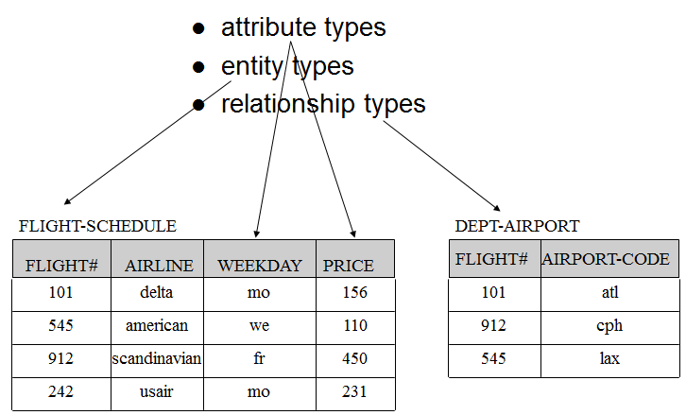
Data Model - Data Structures
All data models have notation for defining:

Slide 22
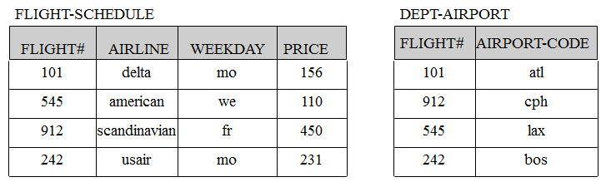
Data Model - Constraints
Constraints express rules that cannot be expressed by the data structures alone:
Static constraints apply to database state
Dynamic constraints apply to change of database state
E.g., “All FLIGHT-SCHEDULE entities must have precisely one DEPT-AIRPORT relationship

Slide 23
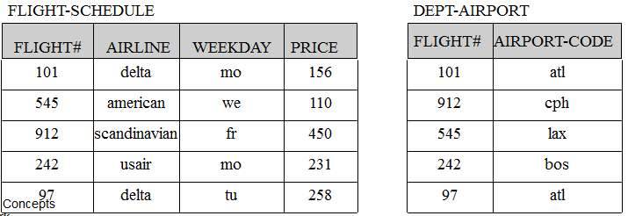
Data Model - Operations
Operations support change and retrieval of data:
insert FLIGHT-SCHEDULE(97, delta, tu, 258); insert DEPT-AIRPORT(97, atl);
select FLIGHT#, WEEKDAY
from FLIGHT-SCHEDULE
where AIRLINE=‘delta’;

Slide 24
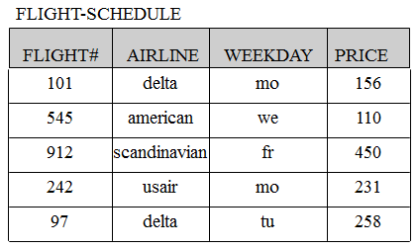
Data Model - Operations from Programs
declare C cursor for
select FLIGHT#, WEEKDAY
from FLIGHT-SCHEDULE
where AIRLINE=‘delta’;
open C;
repeat
fetch C into :FLIGHT#, :WEEKDAY;
do your thing;
until done;
close C;

Slide 25
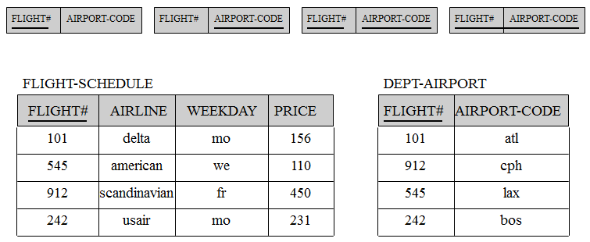
Keys and Identifiers
Keys (or identifiers) are uniqueness constraints
A key on FLIGHT# in FLIGHT-SCHEDULE will force all FLIGHT#’s to be unique in FLIGHT-SCHEDULE
Consider the following keys on DEPT-AIRPORT:

Slide 26
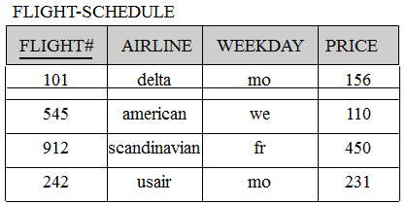
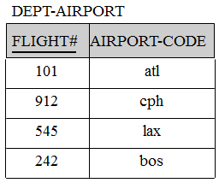
Integrity and Consistency
Integrity: does the model reflect reality well?
Consistency: is the model without internal conflicts?
a FLIGHT# in FLIGHT-SCHEDULE cannot be null because it models the existence of an entity in the real world
a FLIGHT# in DEPT-AIRPORT must exist in FLIGHT-SCHEDULE because it doesn’t make sense for a non-existing FLIGHT-SCHEDULE entity to have a DEPT-AIRPORT

Slide 27
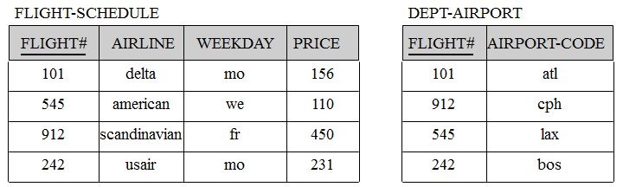
Triggers and Stored Procedures
Triggers can be defined to enforce constraints on a database, e.g.,
DEFINE TRIGGER DELETE-FLIGHT-SCHEDULE
ON DELETE FROM FLIGHT-SCHEDULE WHERE FLIGHT#=‘X’
ACTION DELETE FROM DEPT-AIRPORT WHERE FLIGHT#=‘X’;

Slide 28
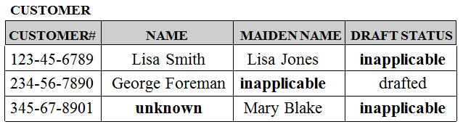
Null Values
Null-value unknown reflects that the attribute does apply, but the value is currently unknown. That’s ok!
Null-value inapplicable indicates that the attribute does not apply. That’s bad!
Null-value inapplicable results from the direct use of “catch all forms” in database design.
“Catch all forms” are ok in reality, but detrimental in database design.

Slide 29
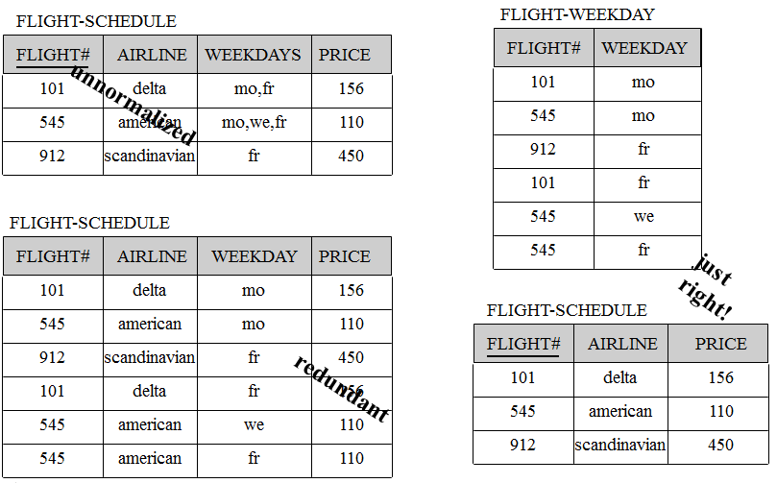
Normalization

Slide 30
Surrogates - Things and Names
reality
name
custom#
customer
custom# name addr
customer
addr
name-based representation
reality
name
custom#
customer
customer
custom# name addr
customer
addr
surrogate-based representation
name-based: a thing is what we know about it
surrogate-based: “Das ding an sich” [Kant]
surrogates are system-generated, unique, internal identifiers

Slide 31
Contents
1
Database
2
Database Terminology
3
Data Model Overview
4
Database architecture
5
Database Management System
6
Database Market

Slide 32
3. DATA MODEL OVERVIEW
ER-Model
Hierarchical Model
Network Model
Inverted Model - ADABAS
Relational Model
Object-Oriented Model(s)

Slide 33
ER-Model
Data Structures
Integrity Constraints
Operations
The ER-Model is extremely successful as a database design model
Translation algorithms to many data models
Commercial database design tools, e.g., ERwin No generally accepted query language
No database system is based on the model

Slide 34
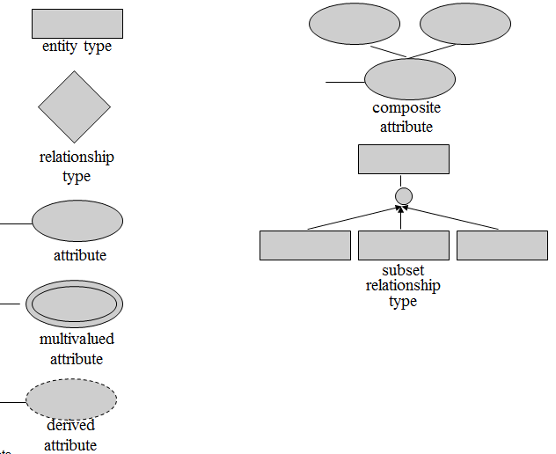
ER-Model - Data Structures

Slide 35
ER-Model - Integrity Constraints
1
R
n
A
E1
E2
cardinality: 1:n for E1:E2 in R
key attribute
R
(min,max)
E1
E2
E
(min,max) participation of E2 in R
R
E1
E2
E3
E1
E2
disjoint
d
total participation of E2 in R
exclusion
x
R
partition
R
p
E1
E2
weak entity type E2; identifying relationship type R

Slide 36
ER Model - Example
visa
required
dept
time
domestic
flight
international
flight
airport
name
airport
code
dept
airport
1
n
p
weekdays
airport
addr
airport
flight
schedule
1
arriv
airport
n
street
city
zip
1
flight#
arriv
time
instance
of
customer#
date
n
n
reserva-
tion
n
customer
name
customer
flight
instance
seat#

Slide 37
ER-Model - Operations
Several navigational query languages have been proposed
A closed query language as powerful as relational languages has not been developed
None of the proposed query languages has been generally accepted

Slide 38
Hierarchical Model
Data Structures
Integrity Constraints
Operations
Commercial systems include IBM’s IMS, MRI’s System-2000 (now sold by SAS), and CDC’s MARS IV

Slide 39
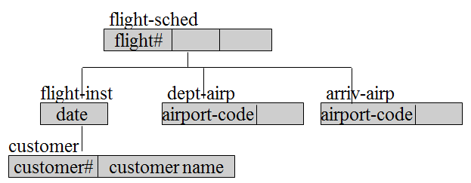
Hierarchical Model - Data Structures
record types: flight-schedule, flight-instance, etc.
field types: flight#, date, customer#, etc.
parent-child relationship types (1:n only!!):
(flight-sched,flight-inst), (flight-inst,customer)
one record type is the root, all other record types is a child of one parent record type only
substantial duplication of customer instances
asymmetrical model of n:m relationship types

Slide 40
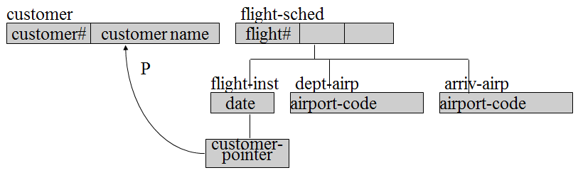
Hierarchical Model - Data Structures - virtual records
duplication of customer instances avoided
still asymmetrical model of n:m relationship types

Slide 41
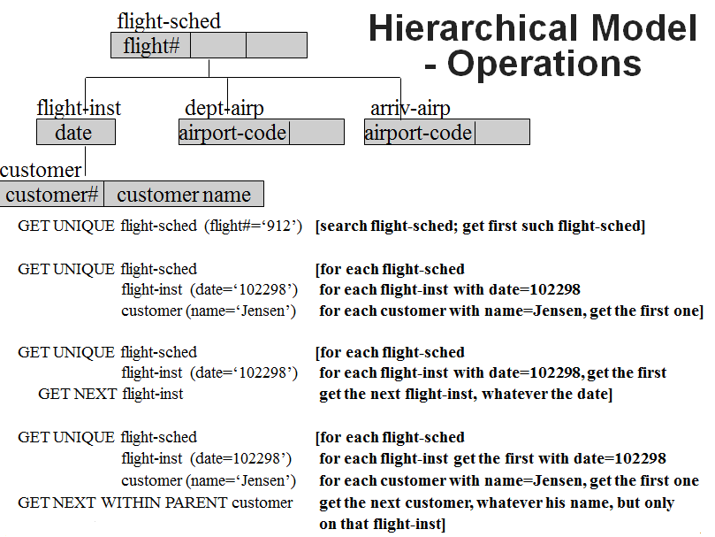
Hierarchical Model - Operations

Slide 42
Network Model
Data Structures
Integrity Constraints
Operations
Based on the CODASYL-DBTG 1971 report
Commercial systems include, CA-IDMS and DMS-1100

Slide 43
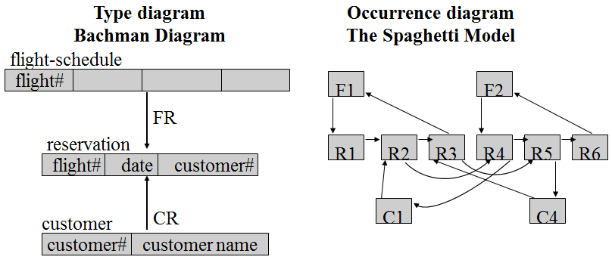
Network Model - Data Structures
owner record types: flight-schedule, customer
member record type: reservations
DBTG-set types: FR, CR
n-m relationships cannot be modeled directly
recursive relationships cannot be modeled directly

Slide 44
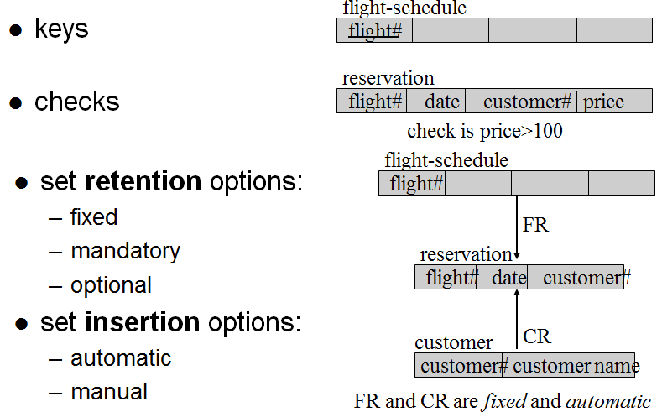
Network Model - Integrity Constraints

Slide 45
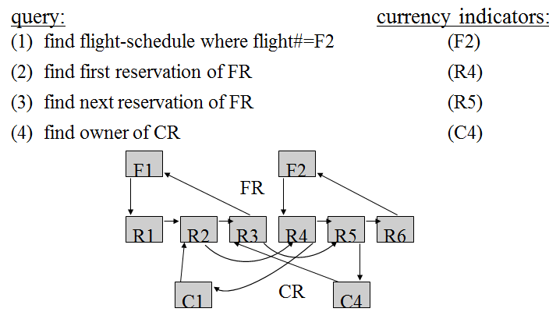
Network Model - Operations
The operations in the Network Model are generic, navigational, and procedural

Slide 46
Network Model - Operations
navigation is cumbersome; tuple-at-a-time
many different currency indicators
multiple copies of currency indicators may be needed if the same path is traveled twice
external schemata are only sub-schemata

Slide 47
Relational Model
Data Structures
Integrity Constraints
Operations
Commercial systems include: ORACLE, DB2, SYBASE, INFORMIX, INGRES, SQL Server
Dominates the database market on all platforms

Slide 48
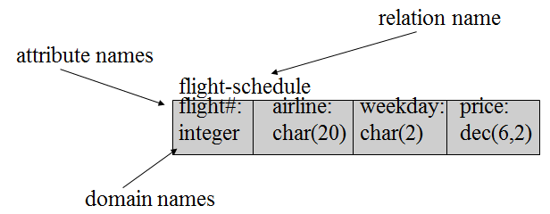
Relational Model - Data Structures
domains
attributes
relations

Slide 49
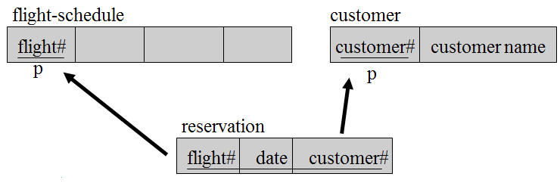
Relational Model - Integrity Constraints
Keys
Primary Keys
Entity Integrity
Referential Integrity

Slide 50
Relational Model - Operations
Powerful set-oriented query languages
Relational Algebra: procedural; describes how to compute a query; operators like JOIN, SELECT, PROJECT
Relational Calculus: declarative; describes the desired result, e.g. SQL, QBE
insert, delete, and update capabilities

Slide 51
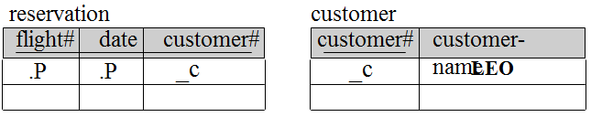
Relational Model - Operations
tuple calculus example (SQL)
select flight#, date
from reservation R, customer C
where R.customer#=C.customer#
and customer-name=‘LEO’;
algebra example (ISBL)
((reservation join customer) where customer-name=‘LEO’) [flight#, date];
domain calculus example (QBE)

Slide 52
Object-Oriented Model(s)
Based on the object-oriented paradigm,
e.g., Simula, Smalltalk, C++, Java
Area is in a state of flux
object-oriented model has object-oriented repository model; adds persistence and database capabilities; (see ODMG-93, ODL, OQL)
object-oriented commercial systems include GemStone, Ontos, Orion-2, Statice, Versant, O2
object-relational model has relational repository model; adds object-oriented features; (see SQL3)
object-relational commercial systems include Starburst, POSTGRES

Slide 53
Object-Oriented Paradigm
object class
object attributes, primitive types, values
object interface, methods; body, implementations
messages; invoke methods; give method name and parameters; return a value
encapsulation
visible and hidden attributes and methods
object instance; object constructor & destructor
object identifier, immutable
complex objects; multimedia objects; extensible type system
subclasses; inheritance; multiple inheritance
operator overloading
references represent relationships
transient & persistent objects

Slide 54
Object-Oriented Model - Structures
class flight-schedule {
type tuple (flight#: integer,
weekdays: set ( weekday: enumeration {mo,tu,we,th,fr,sa,su})
dept-airport: airport, arriv-airport: airport)
method reschedule(new-dept: airport, new-arriv: airport)}
class international-flight inherit flight-schedule {
type tuple (visa-required:string)
method change-visa-requirement(v: string): boolean}
/* the reschedule method is inherited by international-flight; */
/* when reschedule is invoked in international-flight it may */
/* also invoke change-visa-requirement */

Slide 55
class flight-instance {
type tuple (flight-date: tuple ( year: integer, month: integer, day: integer);
instance-of: flight-schedule,
passengers: set (customer) inv customer::reservations)
method add-passenger(new-passenger:customer):boolean,
/*adds to passengers; invokes customer.make-reservation */
remove-passenger(passenger: customer):boolean}
/*removes from passengers; invokes customer.cancel-reservation*/
class customer {
type tuple (customer#: integer,
customer-name: tuple ( fname: string, lname: string)
reservations: set (flight-instance) inv flight-instance::passengers)
method make-reservation(new-reservation: flight-instance): boolean,
cancel-reservation(reservation: flight-instance): boolean}

Slide 56
Object-Oriented Model - Updates
class customer {
type tuple (customer#: integer,
customer-name: tuple ( fname: string, lname: string)
reservations: set (flight-instance) inv flight-instance::passengers)
main () {
transaction::begin();
all-customers: set( customer); /*makes persistent root to hold all customers */
customer c= new customer; /*creates new customer object */
c= tuple (customer#: “111223333”,
customer-name: tuple( fname: “Leo”, lname: “Mark”));
all-customers += set( c); /*c becomes persistent by attaching to root */
transaction::commit();}

Slide 57
Object-Oriented Model - Queries
“Find the customer#’s of all customers with first name Leo”
select tuple (c#: c.customer#)
from c in customer
where c.customer-name.fname = “Leo”;
“Find passenger lists, each with a flight# and a list of customer names, for flights out of Atlanta on October 22, 1998”
select tuple(flight#: f.instance-of.flight#,
passengers: select( tuple( c.customer#, c.customer-name.lname)))
from f in flight-instance, c in f.passengers
where f.flight-date=(1998, 10, 22)
and f.instance-of.dept-airport.airport-code=“Atlanta”;

Slide 58
Contents
1
Database
2
Database Terminology
3
Data Model Overview
4
Database architecture
5
Database Management System
6
Database Market

Slide 59
4. DATABASE ARCHITECTURE
ANSI/SPARC 3-Level DB Architecture
Metadata - What is it? Why is it important?
ISO Information Resource Dictionary System (ISO-IRDS)

Slide 60
ANSI/SPARC 3-Level DB Architecture - separating concerns
DML
database system
database system
DDL
database
schema
data
a database is divided into schema and data
the schema describes the intension (types)
the data describes the extension (data)
Why? Effective! Efficient!

Slide 61
ANSI/SPARC 3-Level DB Architecture - separating concerns
schema
data
schema
internal schema
data
external schema
conceptual schema
internal schema
data

Slide 62
ANSI/SPARC 3-Level DB Architecture
external
schema1
external
schema2
external
schema3
conceptual
schema
external schema:
use of data
conceptual schema:
meaning of data
internal schema:
storage of data
internal
schema
database

Slide 63
Conceptual Schema
Describes all conceptually relevant, general, time-invariant structural aspects of the universe of discourse
Excludes aspects of data representation and physical organization, and access
CUSTOMER
NAME ADDR SEX AGE
An object-oriented conceptual schema would also describe all process aspects

Slide 64
External Schema
Describes parts of the information in the conceptual schema in a form convenient to a particular user group’s view
Is derived from the conceptual schema
MALE-TEEN-CUSTOMER
NAME ADDR
TEEN-CUSTOMER(X, Y) =
CUSTOMER(X, Y, S, A)
WHERE SEX=M AND 12<A<20;
CUSTOMER
NAME ADDR SEX AGE

Slide 65
Internal Schema
Describes how the information described in the conceptual schema is physically represented to provide the overall best performance
CUSTOMER
NAME ADDR SEX AGE
CUSTOMER
NAME ADDR SEX AGE
B⁺-tree on AGE
index on NAME
NAME PTR

Slide 66
Physical Data Independence
external
schema1
external
schema2
external
schema3
conceptual
schema
internal
schema
Physical data independence is a measure of how much the internal schema can change without affecting the application programs
database

Slide 67
Logical Data Independence
external
schema1
external
schema2
external
schema3
conceptual
schema
internal
schema
Logical data independence is a measure of how much the conceptual schema can change without affecting the application programs
database

Slide 68
Schema Compiler
The schema compiler compiles schemata and stores them in the metadatabase
metadata
compiler
schemata
Catalog
Data Dictionary
Metadatabase

Slide 69
Query Transformer
metadata
Uses metadata to transform a query at the external schema level to a query at the storage level
DML
query transformer
query transformer
data

Slide 70
ANSI/SPARC DBMS Framework
enterprise administrator
1
3
3
database administrator
conceptual schema processor
application system administrator
schema compiler
13
2
4
14
5
internal schema processor
external schema processor
metadata
34
36
38
query transformer
21
30
31
12
data
storage internal transformer
internal conceptual transformer
conceptual external transformer
user

Slide 71
Metadata - What is it?
System metadata:
  Where data came from
  How data were changed
  How data are stored
  How data are mapped
  Who owns data
  Who can access data
  Data usage history
  Data usage statistics
Business metadata:
  What data are available
  Where data are located
  What the data mean
  How to access the data
  Predefined reports
  Predefined queries
  How current the data are
Metadata - Why is it important?
System metadata are critical in a DBMS
Business metadata are critical in a data warehouse

Slide 72
ISO-IRDS - Why?
Are metadata different from data?
Are metadata and data stored separately?
Are metadata and data described by different models?
Is there a schema for metadata? A metaschema?
Are metadata and data changed through different interfaces?
Can a schema be changed on-line?
How does a schema change affect data?

Slide 73
ISO-IRDS Architecture
DL
metaschema
metaschema; describes all schemata that can be defined in the data model
data dictionary
data dictionary schema; contains copy of metaschema; schema for format definitions; schema for data about application data
schema
data dictionary
data
data dictionary data; schema for application data; data about application data
data
raw formatted application data

Slide 74
ISO-IRDS - example
metaschema
relations
rel-name
att-name
dom-name
access-rights
data dictionary
schema
user
relation
operation
relations
rel-name
att-name
dom-name
data dictionary
(u1, supplier, insert)
(u2, supplier, delete)
supplier
s#
sname
location
data
(s1, smith, london)
(s2, jones, boston)

Slide 75
Contents
1
Database
2
Database Terminology
3
Data Model Overview
4
Database architecture
5
Database Management System
6
Database Market

Slide 76
5. DATABASE MANAGEMENT SYSTEM ARCHITECTURE
Teleprocessing Database
File-Sharing Database
Client-Server Database - Basic
Client-Server Database - w/Caching
Distributed Database
Federated Database
Multi-Database
Parallel Databases

Slide 77
Teleprocessing Database
dumb terminal
dumb terminal
dumb terminal
communication lines
OSTP
AP1
AP2
AP3
mainframe
DBMS
OSDB
database
DB

Slide 78
Teleprocessing Database - characteristics
Dumb terminals
APs, DBMS, and DB reside on central computer
Communication lines are typically phone lines
Screen formatting transmitted via communication lines
User interface character oriented and primitive
Dumb terminals are gradually being replaced by micros

Slide 79
File-Sharing Database
AP1
AP2
AP3
DBMS
DBMS
micros
OSNET
OSNET
LAN
OSNET
file server
micro
OSDB
database
DB

Slide 80
File-Sharing Database - characteristics
APs and DBMS on client micros
File-Server on server micro
Clients and file-server communicate via LAN
Substantial traffic on LAN because large files (and indices) must be sent to DBMS on clients for processing
Substantial lock contention for extended periods of time for the same reason
Good for extensive query processing on downloaded snapshot data
Bad for high-volume transaction processing

Slide 81
Client-Server Database - Basic
AP1
AP2
AP3
micros
OSNET
OSNET
LAN
OSNET
micro(s) or mainframe
DBMS
OSDB
database
DB

Slide 82
Client-Server Database - Basic - characteristics
APs on client micros
Database-server on micro or mainframe
Multiple servers possible; no data replication
Clients and database-server communicate via LAN
Considerably less traffic on LAN than with file-server
Considerably less lock contention than with file-server

Slide 83
Client-Server Database - w/Caching
AP1
AP2
AP3
micros
DBMS
DBMS
OSNET
OSNET
LAN
DB
DB
OSNET
micro(s) or mainframe
DBMS
OSDB
database
DB

Slide 84
Client-Server Database - w/Caching - characteristics
DBMS on server and clients
Database-server is primary update site
Downloaded queries are cached on clients
Change logs are downloaded on demand
Cached queries are updated incrementally
Less traffic on LAN than with basic client-server database because only initial query result is downloaded followed by change logs
Less lock contention than with basic client-server database for same reason

Slide 85
Distributed Database
AP1
AP2
AP3
micros(s) or mainframes
DDBMS
DDBMS
OSNET&DB
OSNET&DB
network
external
external
external
conceptual
internal
DB
DB
DB

Slide 86
Distributed Database - characteristics
APs and DDBMS on multiple micros or mainframes
One distributed database
Communication via LAN or WAN
Horizontal and/or vertical data fragmentation
Replicated or non-replicated fragment allocation
Fragmentation and replication transparency
Data replication improves query processing
Data replication increases lock contention and slows down update transactions

Slide 87
Distributed Database - Alternatives
A
C
partitioned
non-replicated
B
D
increasing cost, complexity, difficulty of control, security risk
increasing parallelism, independence, flexibility, availability
A
C
A
C
non-partitioned
replicated
B
D
B
D
A
C
C
partitioned
replicated
B
D
+
-

Slide 88
Federated Database
AP1
AP2
AP3
micros(s) or mainframes
DDBMS
DDBMS
OSNET&DB
OSNET&DB
network
federation
schema
export
schema1
export
schema2
export
schema3
conceptual1
conceptual2
conceptual3
internal1
internal2
internal3
DB
DB
DB

Slide 89
Federated Database - characteristics
Each federate has a set of APs, a DDBMS, and a DB
Part of a federate’s database is exported, i.e., accessible to the federation
The union of the exported databases constitutes the federated database
Federates will respond to query and update requests from other federates
Federates have more autonomy than with a traditional distributed database

Slide 90
Multi-Database
AP1
AP2
AP3
micros(s) or mainframes
MULTI-DBMS
MULTI-DBMS
OSNET&DB
OSNET&DB
network, e.g
WWW
conceptual1
conceptual2
conceptual3
internal1
internal2
internal3
DB
DB
DB

Slide 91
Multi-Database - characteristics
A multi-database is a distributed database without a shared schema
A multi-DBMS provides a language for accessing multiple databases from its APs
A multi-DBMS accesses other databases via a network, like the www
Participants in a multi-database may respond to query and update requests from other participants
Participants in a multi-database have the highest possible level of autonomy

Slide 92
Parallel Databases
A database in which a single query may be executed by multiple processors working together in parallel
There are three types of systems:
  Shared memory
  Shared disk
  Shared nothing

Slide 93
Parallel Databases - Shared Memory
processors share memory via bus
extremely efficient processor communication via memory writes
bus becomes the bottleneck
not scalable beyond 32 or 64 processors
P
M
P
P
P
P
processor
M
memory
disk

Slide 94
Parallel Databases - Shared Disk
processors share disk via interconnection network
memory bus not a bottleneck
fault tolerance wrt. processor or memory failure
scales better than shared memory
interconnection network to disk subsystem is a bottleneck
used in ORACLE Rdb
M
P
M
P
M
P
M
P

Slide 95
Parallel Databases - Shared Nothing
scales better than shared memory and shared disk
main drawbacks:
  higher processor communication cost
  higher cost of non-local disk access
used in the Teradata database machine
M
P
M
P
M
P
M
P

Slide 96
RAID - redundant array of inexpensive disks
disk striping improves performance via parallelism
(assume 4 disks worth of data is stored)
disk mirroring improves reliability via redundancy (assume 4 disks worth of data is stored)
mirroring: via copy of data (c); via bit parity (p)
c
c
c
c
p

Slide 97
DATABASE CAPABILITIES
Data Storage
Queries
Optimization
Indexing
Concurrency Control
Recovery
Security

Slide 98
Data Storage
Disk management
File management
Buffer management
Garbage collection
Compression

Slide 99
Queries
SQL queries are composed from the following:
Selection
  Point
  Range
  Conjunction
  Disjunction
Join
  Natural join
  Equi join
  Theta join
  Outer join
Projection
Set operations
  Cartesian Product
  Union
  Intersection
  Set Difference
Other
  Duplicate elimination
  Sorting
  Built-in functions: count, sum, avg, min, max
Recursive (not in SQL)

Slide 100
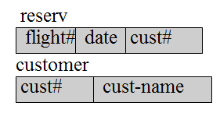
Query Optimization
select flight#, date
from reserv R, cust C
where R.cust#=C.cust#
and cust-name=‘LEO’;
10,000 reserv blocks
3,000 cust blocks
30 “Leo” blocks
flight#, date
flight#, date
cost: 10,000x30
cust-name=Leo
cust#
cost: 10,000x3,000
cust-name=Leo
reserv
cust
reserv
cust
cost: 3,000

Slide 101
Query Optimization
Database statistics
Query statistics
Index information
Algebraic manipulation
Join strategies
  Nested loops
  Sort-merge
  Index-based
  Hash-based

Slide 102
Indexing
Why Bother?
Disk access time: 0.01-0.03 sec
Memory access time: 0.000001-0.000003 sec
Databases are I/O bound
Rate of improvement of
(memory access time)/(disk access time) >>1
Things won’t get better anytime soon!
Indexing helps reduce I/O !

Slide 103
Indexing (cont.)
Clustering vs. non-clustering
Primary and secondary indices
I/O cost for lookup:
  Heap: N/2
  Sorted file: log₂(N)
  Single-level index: log₂(n)+1
  Multi-level index; B⁺-tree: log_{fanout}(n)+1
  Hashing: 2-3
View caching; incremental computation

Slide 104
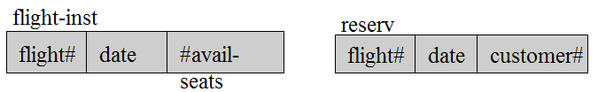
Concurrency Control
T1:
read(flight-inst(flight#,date)
seats:=#avail-seats
if seats>0 then {
seats:=seats-1
write(reserv(flight#,date,customer1))
write(flight-inst(flight#,date,seats))}
T2:
read(flight-inst(flight#,date)
seats:=#avail-seats
if seats>0 then {
seats:=seats-1
write(reserv(flight#,date,customer2))
write(flight-inst(flight#,date,seats))}
overbooking!

Slide 105
Concurrency Control (cont.)
ACID Transactions:
An ACID transaction is a sequence of database operations that has the following properties:
Atomicity
  Either all operations are carries out, or none is
  This property is the responsibility of the concurrency control and the recovery sub-systems
Consistency
  A transaction maps a correct database state to another correct state
  This requires that the transaction is correct, which is the responsibility of the application programmer

Slide 106
Concurrency Control (cont.)
Isolation
  Although multiple transactions execute concurrently, i.e. interleaved, not parallel, they appear to execute sequentially
  This is the responsibility of the concurrency control sub-system
Durability
  The effect of a completed transaction is permanent
  This is the responsibility of the recovery manager

Slide 107
Concurrency Control (cont.)
Serializability is a good definition of correctness
A variety of concurrency control protocols exist
  Two-phase (2PL) locking
    deadlock and livelock possible
    deadlock prevention: wait-die, wound-wait
    deadlock detection: rollback a transaction
  Optimistic protocol: proceed optimistically; back up and repair if needed
  Pessimistic protocol: do not proceed until knowing that no back up is needed

Slide 108
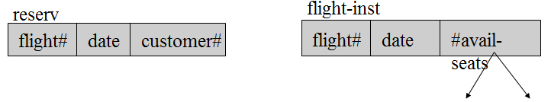
Recovery
102298 102398
change-reservation(DL212,102298,DL212,102398,C)
read(flight-inst(DL212,102298)
#avail-seats:=#avail-seats+1
update(flight-inst(DL212,102298,#avail-seats)
read(flight-inst(DL212,102398)
#avail-seats:=#avail-seats-1
update(flight-inst(DL212,102398,#avail-seats)
update(reserv(DL212,102298,C,DL212,102398,C)
100 50
100 50
100 50
101 50
101 50
101 50
101 49
101 49

Slide 109
Recovery (cont.)
Storage types:
Volatile: main memory
Nonvolatile: disk
Errors:
Logical error: transaction fails; e.g. bad input, overflow
System error: transaction fails; e.g. deadlock
System crash: power failure; main memory lost, disk survives
Disk failure: head crash, sabotage, fire; disk lost
What to do?

Slide 110
Recovery (cont.)
Deferred update (NO-UNDO/REDO):
  don’t change database until ready to commit
  write-ahead to log to disk
  change the database
Immediate update (UNDO/NO-REDO):
  write-ahead to log on disk
  update database anytime
  commit not allowed until database is completely updated
Immediate update (UNDO/REDO):
  write-ahead to log on disk
  update database anytime
  commit allowed before database is completely updated
Shadow paging (NO-UNDO/NO-REDO):
  write-ahead to log in disk
  keep shadow page; update copy only; swap at commit

Slide 111
Security
DAC: Discretionary Access Control
is used to grant/revoke privileges to users, including access to files, records, fields (read, write, update mode)
MAC: Mandatory Access Control
is used to enforce multilevel security by classifying data and users into security levels and allowing users access to data at their own or lower levels only

Slide 112
Contents
1
Database
2
Database Terminology
3
Data Model Overview
4
Database architecture
5
Database Management System
6
Database Market

Slide 113
6. THE DATABASE MARKET
Prerelational vs. Relational
Database Vendors
Relational Database Products
Relational Databases for PCs
Object-Oriented Database Capabilities

Slide 114
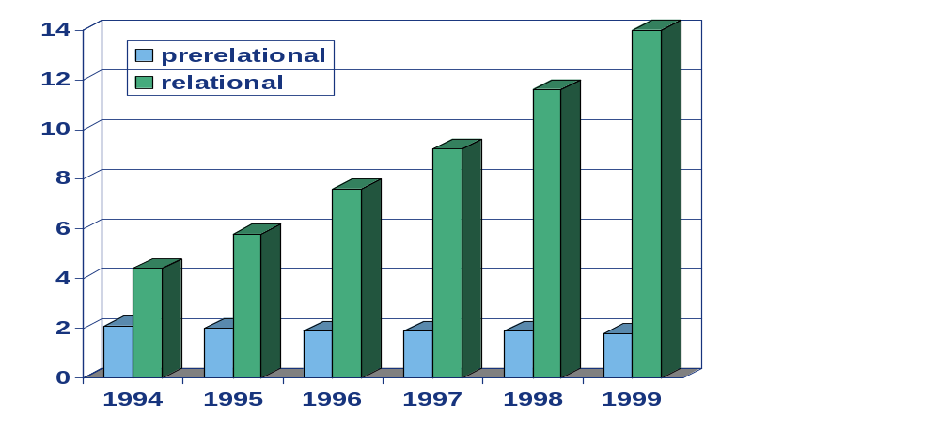
Prerelational vs. Relational
billion $
Prerelational market revenue shrinking about 9%/year. Currently 1.8 billion/year
Relational market revenue growing about 30%/year. Currently 11.5 billion/year
Object-Oriented market revenue about 150 million/year

Slide 115
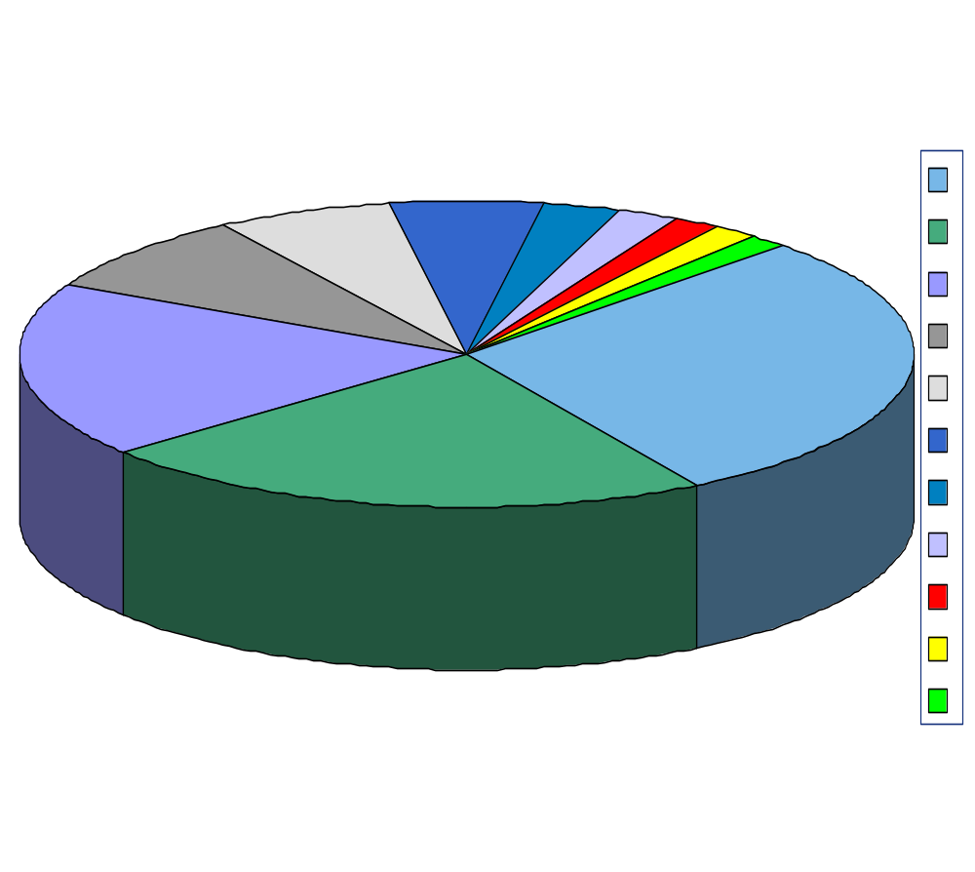
Database Vendors
Other ($2,272M)
Informix
CA
Oracle ($1,755M)
IBM (IMS+DB2) ($1,460M)
Sybase ($664M)
Informix (+Illustra) ($492M)
CA-IDMS (+Ingress) ($447M)
NEC ($211M)
Sybase
IBM
Other
Oracle
Total: $7,847M
Source: IDC, 1995

Slide 116
Relational Database Products
Compare the following products:
ORACLE 7 Version 7.3
Sybase SQL Server 11
Informix OnLine 7.2
Microsoft SQL Server 6.5
IBM DB2 2.1.1
CA-OpenIngres 1.2

Slide 117
Relational Databases for PCs
Relational databases for PCs:
Microsoft FoxPro for Windows
Microsoft FoxPro for DOS
Borland’s Paradox for Windows
Borland’s dBASE IV
Paradox for DOS
R:BASE
Microsoft Access

Slide 118
EMERGING DB TECHNOLOGIES
WEB databases
Multimedia Databases
Mobile Databases
Data Warehousing and Mining
Geographic Information Systems
Genome Data Management
Temporal Databases
Spatial Databases

Slide 119

Questions

Slide 120
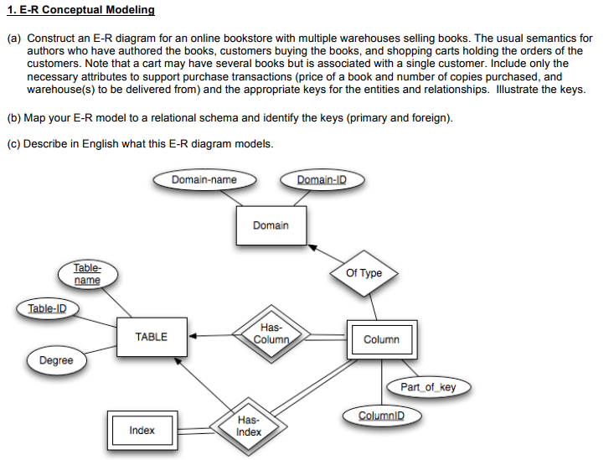
Exercises

Slide 121
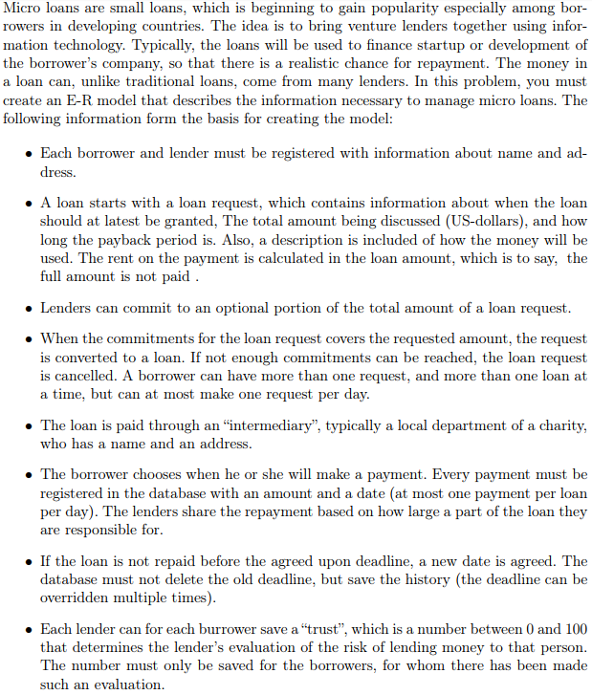
Exercises (2)

Slide 122

Exercises (2)

Slide 123
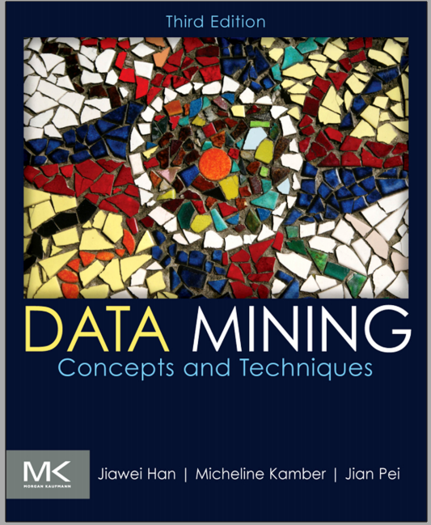
Main reference

Slide 124
Thank You !
Click to edit company slogan .

